Slide 1
Introduction to DevOps

Slide 2
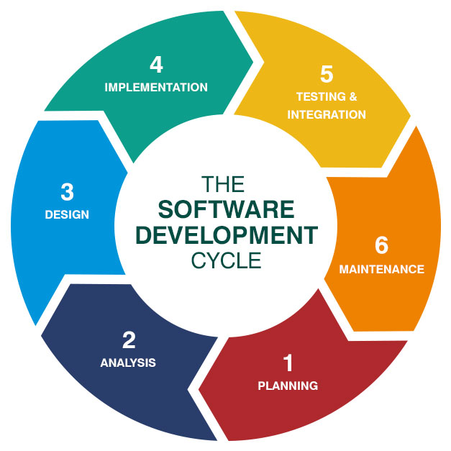
What is SDLC?
Software Development Life Cycle (SDLC) is a process used by the software industry to design, develop and test high quality softwares.
The SDLC aims to produce a high-quality software that meets or exceeds customer expectations, reaches completion within times and cost estimates.
SDLC is a process followed for a software project, within a software organization. It consists of a detailed plan describing how to develop, maintain, replace and alter or enhance specific software.
The life cycle defines a methodology for improving the quality of software and the overall development process.

Slide 3
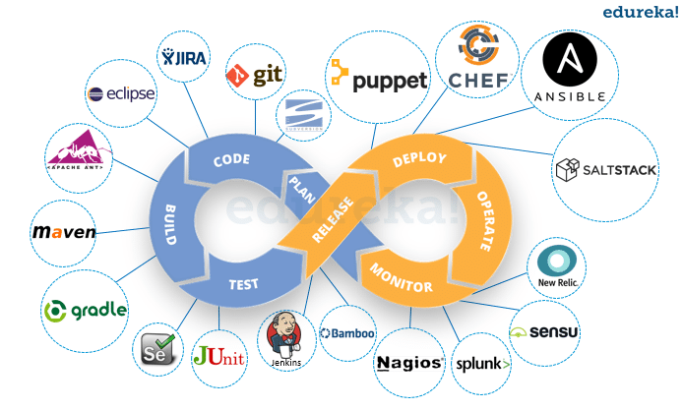
What is DevOps?
DevOps is a set of practices that combines software development (Dev) and IT operations (Ops).
It aims to shorten the systems development life cycle and provide continuous delivery with high software quality.
DevOps is complementary with Agile software development; several DevOps aspects came from the Agile methodology.

Slide 4
Continuous Integration and delivery for Java and Angular based application using Jenkins

Slide 5
What is Continuous Integration?
Continuous Integration (CI) is a development practice where developers integrate code into a shared repository frequently, preferably several times a day.
Each integration can then be verified by an automated build and automated tests.
One of the key benefits of integrating regularly is that you can detect errors quickly and locate them more easily. As each change introduced is typically small, pinpointing the specific change that introduced a defect can be done quickly.

Slide 6
What is Continuous Delivery?
Continuous Delivery is the ability to get changes of all types—including new features, configuration changes, bug fixes and experiments—into production, or into the hands of users, safely and quickly in a sustainable way.
Our goal is to make deployments—whether of a large-scale distributed system, a complex production environment, an embedded system, or an app—predictable, routine affairs that can be performed on demand.

Slide 7
Before Continuous Integration/Delivery? (CI/CD)
Manual Deployments.
Manual Restarts.
Less confidence! Long turnaround time.

Slide 8
Why CI/CD?
Immediate feedback, faster turn around time.
Enforces discipline of frequent automated testing.
Better coding practices - Frequent code check-in pushes developers to create modular, less
complex code.
Every commit can result in a release!

Slide 9
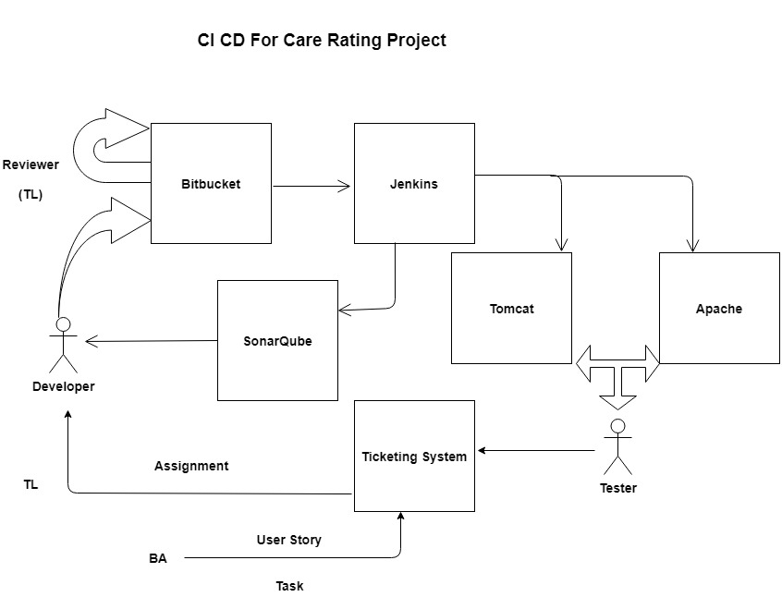
CI/CD Workflow

Slide 10
CI / CD step by step
Developers check out code into their local machines.
Developer commit changes to the source code repository.
Reviewer(TL) review the code and push to release branch
The CI server monitors the source code repository and starts build process.
The CI server builds the system and runs unit and integration tests.
The CI server releases deployable artifacts for testing.
The CI server assigns a build label to the version of the code it just built.
The CI server informs of the successful build.
If the build or tests fail, the CI server alerts the team.
The team fix the issue at the earliest opportunity.
Continue to continually integrate and test throughout the project
CI Server stage / Deploys to Production Environments (Can set up email based approval).

Slide 11
Tools Used
Tools | Options
Source Code Repository | Bitbucket
Continuous Integration Server | Jenkins
Code Analysis | Sonar Qube
Code Analysis Tools(for Java project) | Jacoco
Build Tools (Java and Angular) | Maven, NPM
Web Servers | Apache Tomcat 9.0 and Apache HTTP Server 2.4

Slide 12
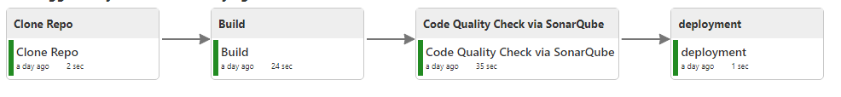
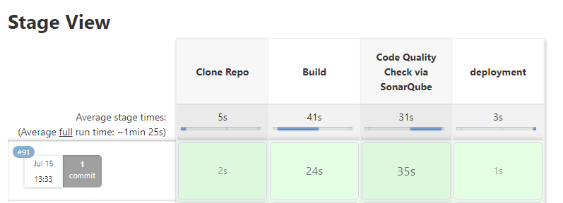
Jenkins Workflow for Java Project

Slide 13
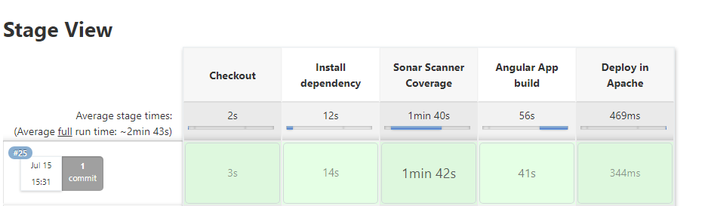
Jenkins Workflow for Angular project

Slide 14
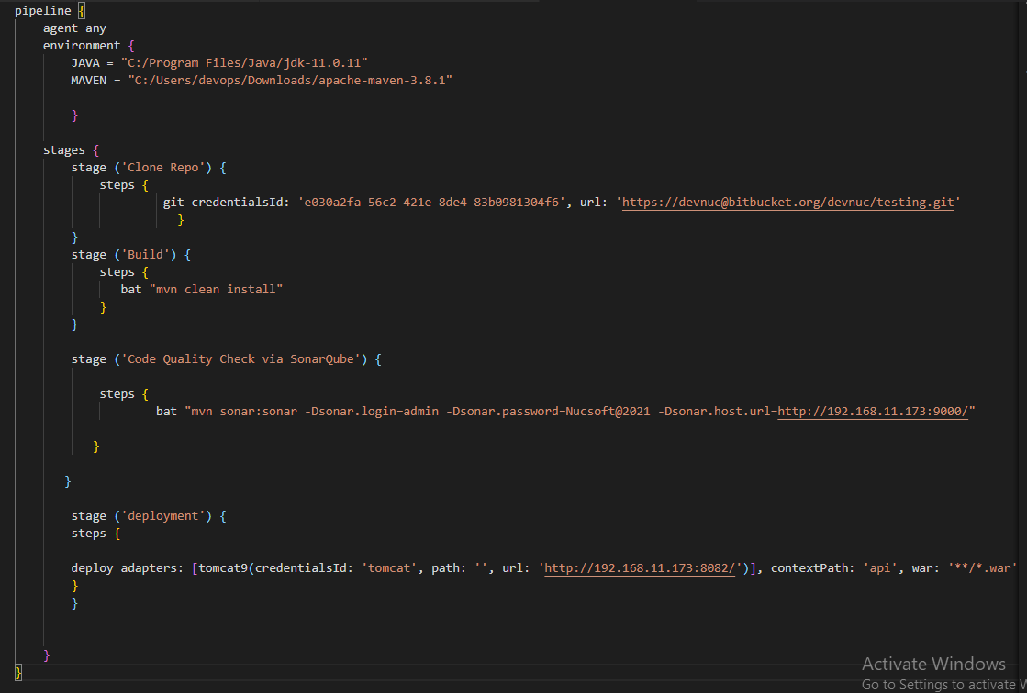
Jenkins Pipeline Script for Java Project

Slide 15
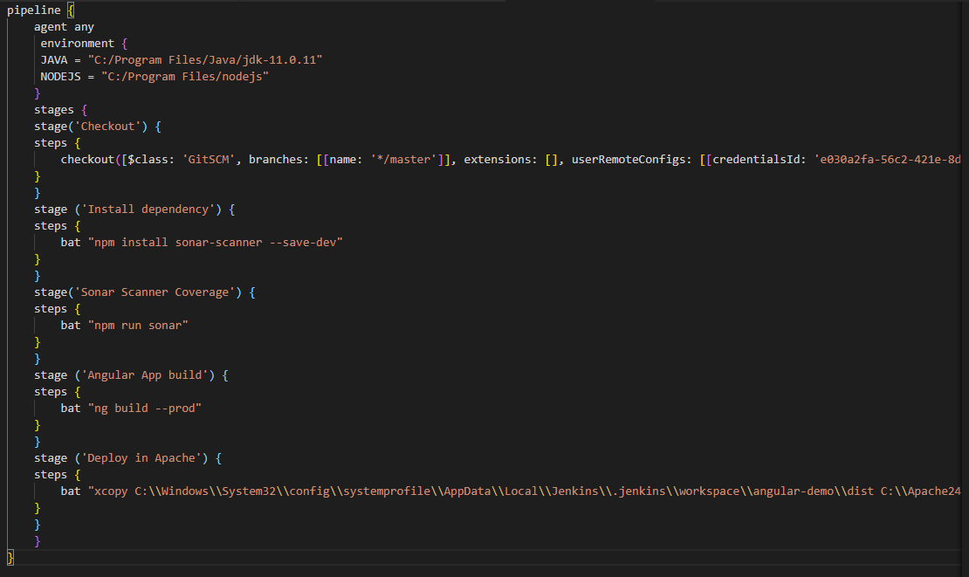
Jenkins Pipeline Script for Angular Project

Slide 16
Code Analysis Tools
JaCoCo
Used for Code Coverage. On the fly byte code instrumentation.
SonarQube
SonarSource for continuous inspection of code quality to perform automatic reviews with static analysis of code to detect bugs, code smells, and security vulnerabilities.

Slide 17
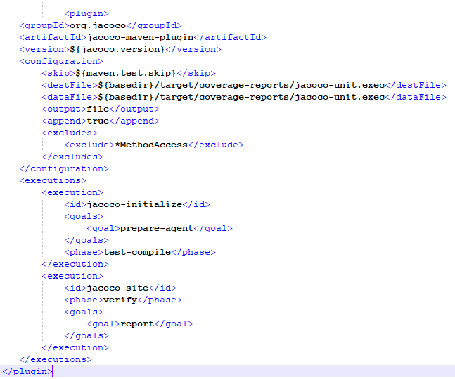
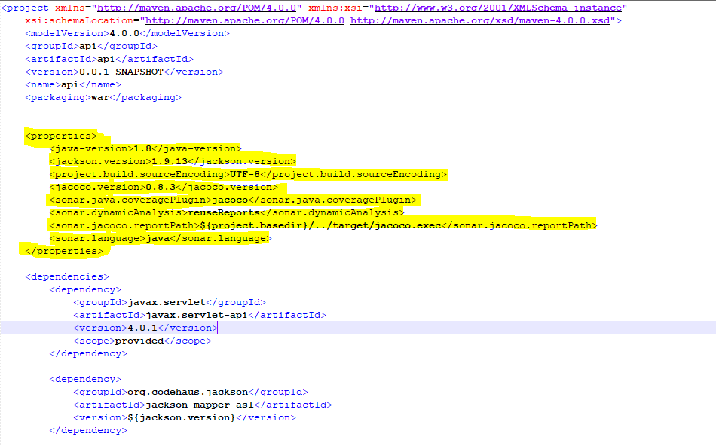
Code Analysis Tools - JaCoCo for Java Project
Add below changes in pom.xml file

Slide 18
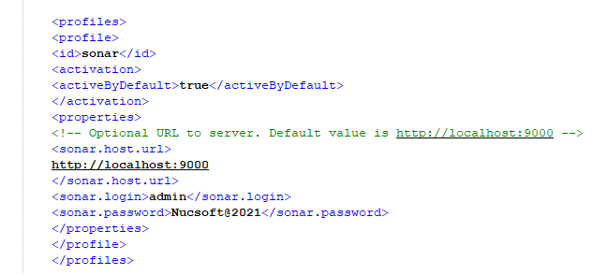
Code Analysis Tools - Sonar for Java Project
Add below changes in pom.xml file

Slide 19
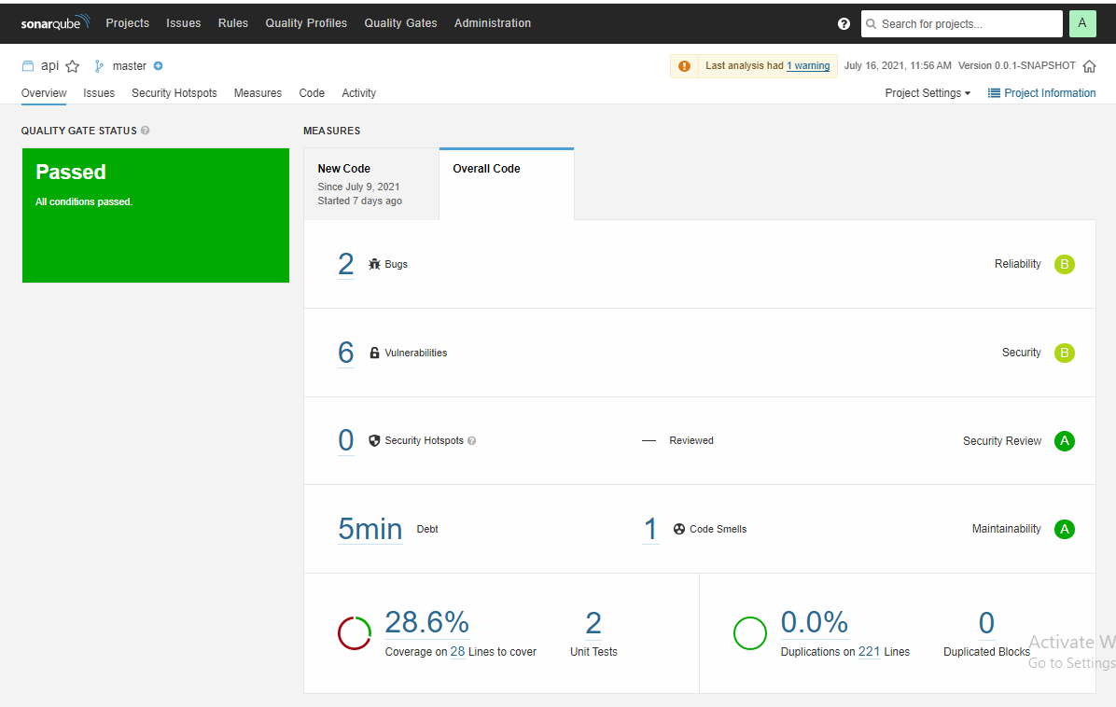
SONAR Dashboard for Java Project

Slide 20
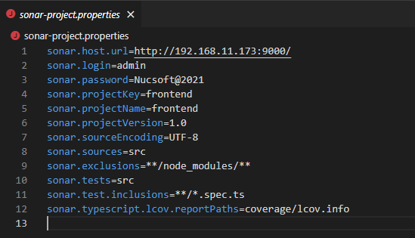
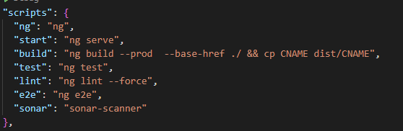
Code Analysis Tools - Sonar for Angular Project
Add below changes in package.jason file
Add below changes in sonar.properties file

Slide 21
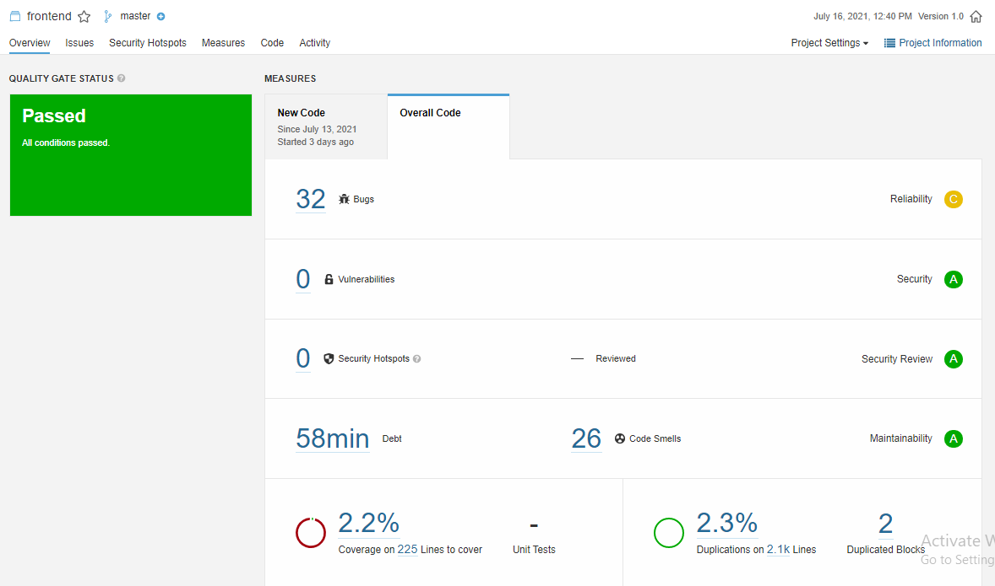
SONAR Dashboard for Angular Project

Slide 22
Great! what all plugins we have to used for Jenkins?
Bitbucket plugin to checkout source code from repo.
Bitbucket plugin for polling and start builds on each checkin.
Build Pipeline plugin.
Deploy to container plugin
Copy Artifacts Plugin
Email Extensions plugin
NodeJS plugin

Slide 23
Thank you so much!

